Slide 1
Viper: An Efficient Hybrid PMem-DRAM Key-Value Store
Conference : VLDB’21
Author : Lawrence Benson, Hendrik Makait, Tilmann Rabl
School : Hasso Plattner Institute, University of Potsdam

Slide 2
Research work—Problem
Existing key-value store has a high cost of deserialization/serialization per access, which seriously affects the overall performance. Emerging persistent memory (PMem) technologies offer data persistence at close-to-DRAM speed, making them a promising alternative to classical disk-based storage. However, simply
drop-in replacing existing storage with PMem does not yield good results.

Slide 3
Research work—Background
Key-Value Stores
To access KVSs, two designs have emerged, KVS servers and embedded KVSs. To provide good performance and control, embedded KVS must design their interfaces as simple as possible without requiring the user to strictly follow patterns or complex procedures in case of, e.g., partial failures or system restarts.
Persistent Memory
byte-addressable data access;
persistence of secondary storage;
close-to-DRAM speed.

Slide 4
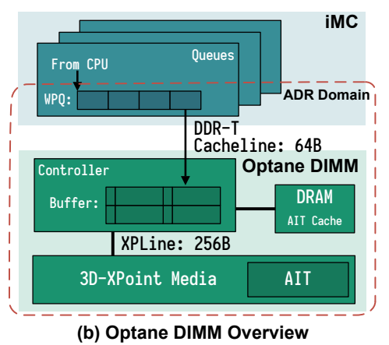
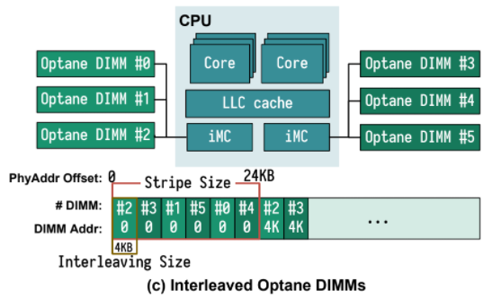
Research work—Background
Persistent Memory

Slide 5
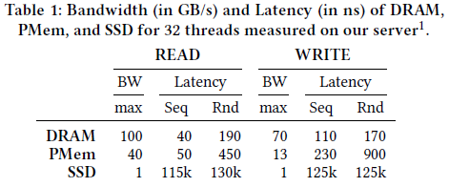
Research work—Background
As PMem has only recently become publicly available, the majority of previous PMem research uses simulations to estimate PMem performance in which key characteristics were assumed incorrectly.
Writing sequentially to PMem is encouraged, while random access should be directed to DRAM
whenever possible.

Slide 6
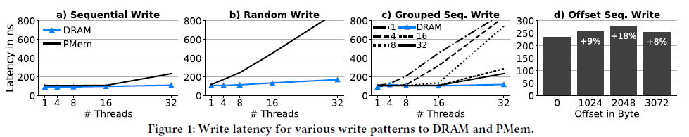
Research work—Motivation
Sequential writes have a similar latency for PMem and DRAM (maximum 2x higher for 32 threads), while random writes perform significantly worse on PMem even for low thread counts.
The threads across k memory regions (1 GB each), representing log files, to which they write sequentially. The threads profit from PMem’s parallelism by writing to varying locations evenly distributed across DIMMs.
4 KB aligned writes (offset = 0) achieve the lowest latency, while a 2 KB offset has an 18% higher latency.

Slide 7
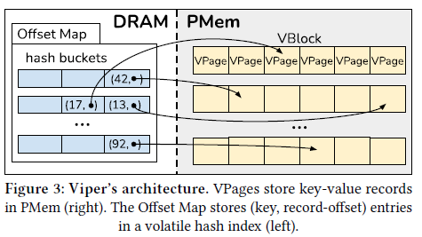
Research work—Solution
Viper consists of a volatile hash index located in DRAM and persistent data blocks located in PMem. All data is durably stored in persistent memory and the hash index contains only references to the storage location.

Slide 8
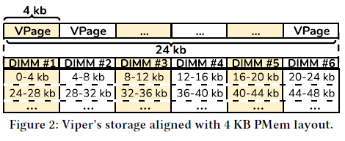
Research work—Challenge and Technique
How to design sequential write strategy in key-value store
Direct PMem writes. As sequential PMem writes are faster than previously assumed in simulations, Viper writes all data directly to PMem without an intermediate DRAM buffer.
How to use Pmem's parallelism to improve write performance
Uniform thread-to-DIMM distribution. Viper minimizes the thread-to-DIMM ratio for inserts by assigning threads to different memory regions.
How to design memory-aligned accesses
DIMM-aligned storage segments. Viper stores data in DIMM boundary-aligned VPages to balance DIMM contention with parallelism. Smaller VPages result in more threads accessing the same DIMM and larger VPages result in a single thread accessing multiple DIMMs, both leading to a worse, and thus disadvantageous, thread-to-DIMM ratio.

Slide 9
Research work—Evaluation
Experiment Setup
An Intel Xeon Gold 5220S CPU server and pin all threads to one socket to avoid cross-socket data access. The CPU has 18 cores (36 logical cores via hyperthreading). The socket is connected to 750 GB PMem, in six 128 GB Intel Optane Persistent Memory DIMMs, and to 96 GB DRAM.
FASTER: hash-based KVS, a hybrid DRAM-PMem system, Write DRAM first, write Pmem in batches
Pmem-rocksdb
Dash: PMem-only, hash-based index
Pmemkv: PMem-only, the cmap backend
μTree: hybrid PMem-DRAM systems, hybrid B-Tree implementation, tree-based index
Cross-Referencing Logs(CRL): hybrid PMem-DRAM systems, bridge the gap between volatile and persistent KVSs by persisting cross-referencing logs between two KVSs, one in DRAM and one in PMem.
Each log is logged twice.

Slide 10
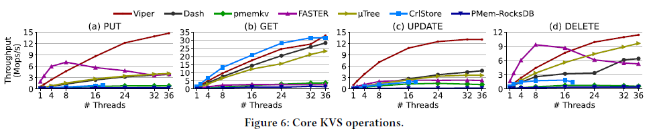
Research work—Evaluation
Key-Value Store Operations.
Initially fill each KVS with 100 million 216 Byte records (16 B key, 200 B value), before performing 50 million individual operations on them.
In (a), Viper’s insert throughput scales well with the number of threads.
(b)FASTER, pmemkv, and RocksDB do not perform well for random get request due to inefficient lookups in PMem.
This shows that get performance heavily depends on the chosen (hash-) index implementation.
In such a workload (c), we see that Viper outperforms all other systems due to its atomic Pmem-aware in-place modification.

Slide 11
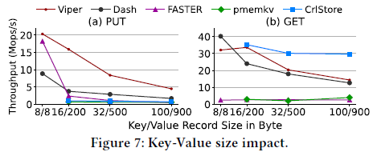
Research work—Evaluation
Key-Value Record Size.
Define a fixed prefill data size of 20 GB, which we divide by the record sizes to get the number of records to prefill each system. We then insert 10 GB in the same manner, i.e., exactly half as many records as the prefill.
Viper decreases linearly with an increasing record size, as it becomes PMem bandwidth-bound.

Slide 12
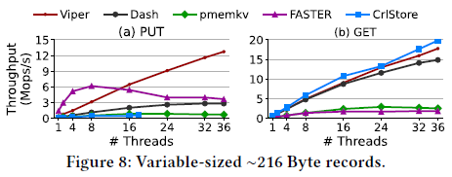
Research work—Evaluation
Variable-sized Records
We prefill 100 million records of about 216 Byte, with a normal distribution around 16 B for the key (N(16, 3.2²)) and 200 B for value size (N(200, 40²)). We then perform each 50 million puts and gets and measure the throughput.

Slide 13
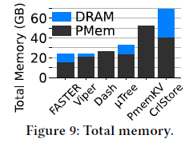
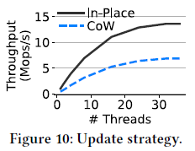
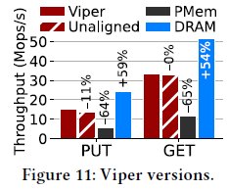
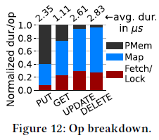
Research work—Evaluation
Memory Consumption. Update Strategy.
Viper Versions Operation Breakdown.

Slide 14
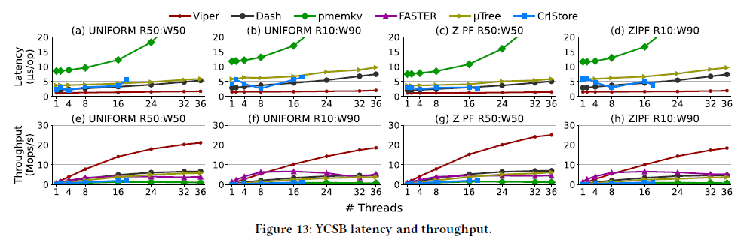
Research work—Evaluation
YCSB

Slide 15
Research work—Conclusion
Viper, a hybrid PMem-DRAM key-value store that leverages PMem-specific access patterns to efficiently store and retrieve data while providing full data persistence.
propose three key design choices for hybrid PMem-DRAM systems based on efficient PMem access patterns for real hardware, direct PMem-writes, uniform thread-to-DIMM distribution, and DIMM-aligned storage segments.
Viper significantly outperforms existing PMem-only, hybrid, and disk-based KVSs by 4–18x for write workloads, while matching or surpassing their get performance.

Slide 16

Q & A
Thank You!

